Slide 1
IMAGE PROCESSING
By
Viral 3

Slide 2
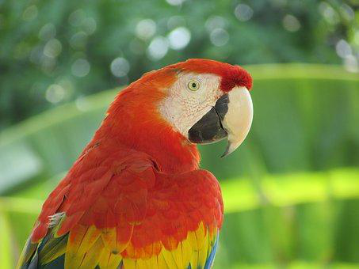
3-Reading, saving, and displaying an image using Matplotlib
The next code block shows how to use the imread() function from matplotlib.image to read an image in a floating-point numpy ndarray. The pixel values are represented as real values between 0 and 1.
***Providing the correct path to the images on the disk***

